Slide 1
Sales presentation
By Nolan Cornelis and Bram Vernimmen

Slide 2
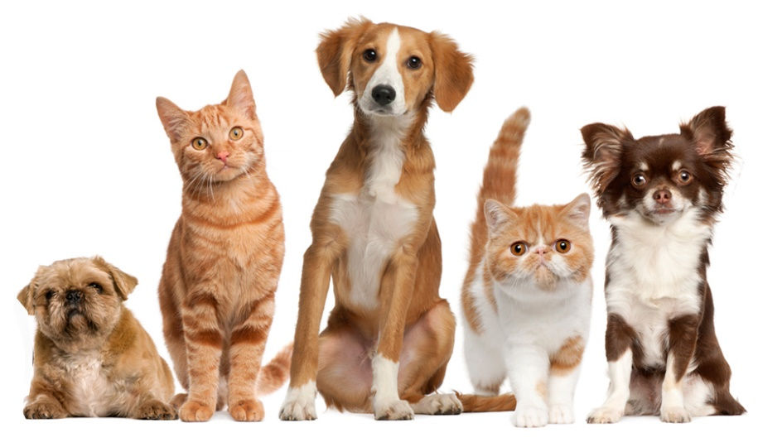
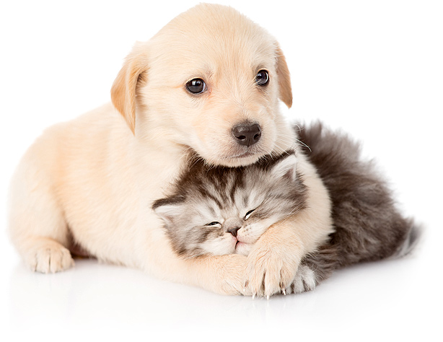
Table of contents
Introduction
Target audience
Objective
Advertisement
Price
Advantages

Slide 3
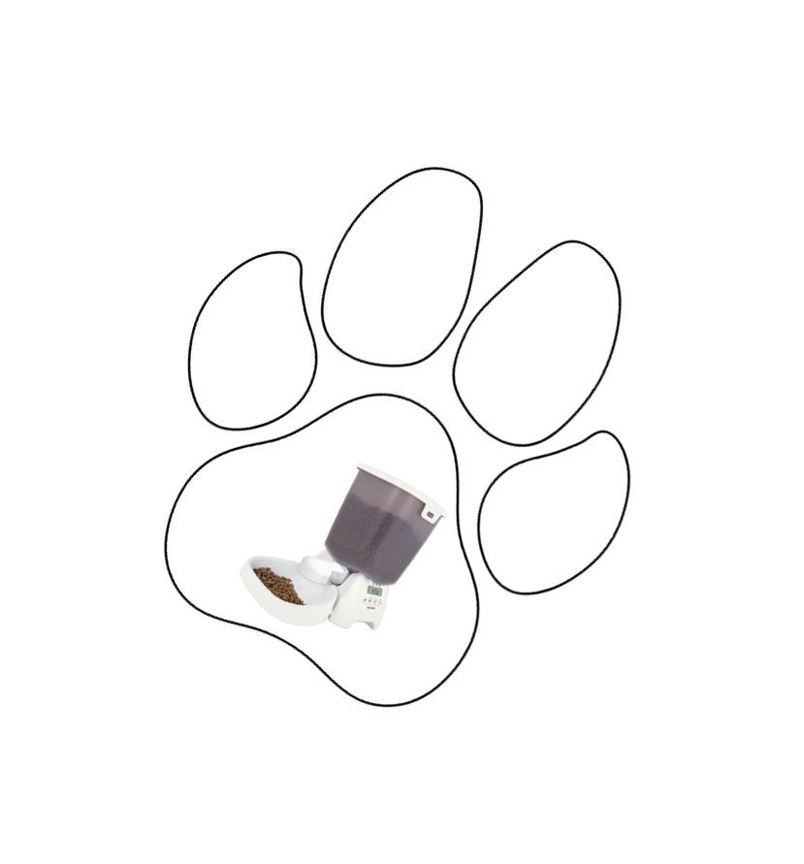
Introduction
Animood = Animal + Food
Automatic pet feeder

Slide 4
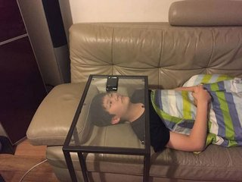
Target audience
Pet owners
Long work days
Vacation
Lazy

Slide 5
Objective
Simplifying the care of pets
Saving time

Slide 6
Advertisement
Google ads
Social media
Brochures

Slide 7
Price
€ 149,95
App = free
Low price ➔ high quality

Slide 8
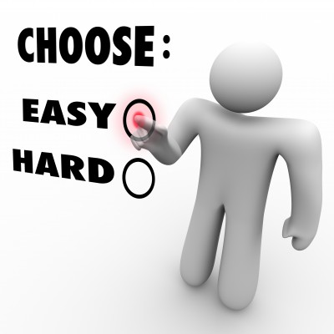
Advantages
App ➔ use it everywhere
No worry about feeding pets
Easily usable ➔ instructions
Easily cleanable
Cheap for quality

Slide 9
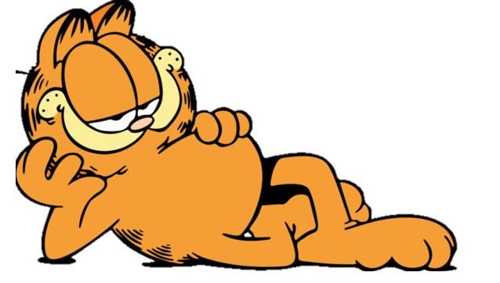
This is the end of our presentation
Thank you for listening

